Slide 1

ECEN 3593-001 Computer Organization
Lecture #16
24 February 2021

Slide 2


Agenda
Class Announcements
Phase 5 Details
Chapter 4

Slide 3
Class Announcements
Reading for the week
“Computer Organization and Design, The Hardware / Software Interface, RISC-V edition,” by David Patterson and John Hennessy
ISBN 978-0-12-812275-4
Chapter 4, “The Processor”
pages 236-314 (sections 4.1 thru 4.8)
OH via Zoom 2:00 to 3:00 today https://cuboulder.zoom.us/j/4317981384

Slide 4
Class Announcements
Phase 5 is available, Target Date Sunday, February 28 at 10:00 PM
1%/day bonus before that, 4%/day penalty after that (Poll)
Phase 6 will be posted by Friday evening
Target Date Sunday, March 7 at 10:00 PM
1%/day bonus before that, 4%/day penalty after

Slide 5
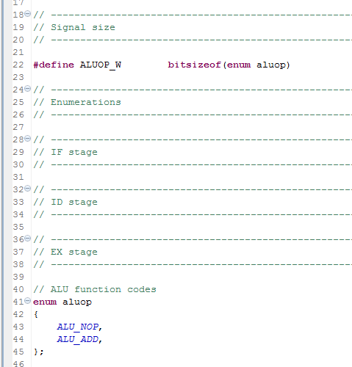
Codasip – ca_defines.hcodal
Defines Control Signal enums and widths
enum – define names for all possible Control signal values
Can easily add additional values in future Phases
Define the bit width as a function of the number of enums – automatically adjusted if enums added
First enum is assigned 0 – the default value
All Control signals MUST be defined in this way, and the enums MUST be used in the code

Slide 6
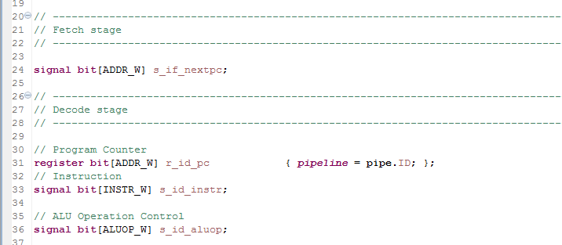
Codasip – ca_resources.codal
Defines all signals used in the design
Signals - [ADDR_W] is the bit width (see share/include/config.hcodal for definitions)
Registers
Must specify the pipeline stage
Control widths like ALUOP_W created in defines.hcodal

Slide 7
Codasip – ca_resources.codal
MUST have the correct width for every signal
Determining Signal Width
All data path widths are 32 bits
WORD_W for data signals like s_ex_alu
ADDR_W for address path signals like r_pc
INSTR_W for the instruction
If the signal has a bitfield specification, that defines the width
All necessary widths have constants in config.hcodal except “1”
The width of every register output is the same as the width of its input

Slide 8
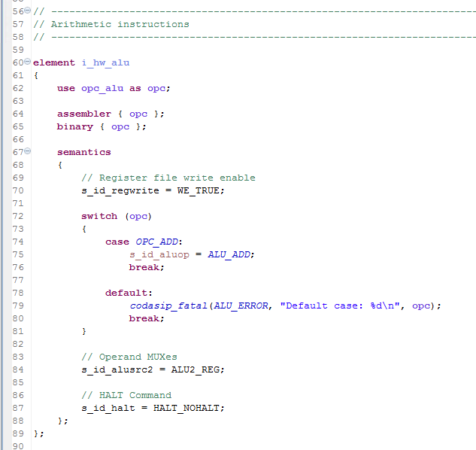
Codasip – ca_decoder.codal
CA Equivalent of isa.codal
element name adds “_hw”
opc_* definitions come from isa.codal
Define the value of every Control signal for this instruction group
Use the enums created in ca_defines.hcodal
Every Control signal must be defined in every group

Slide 9
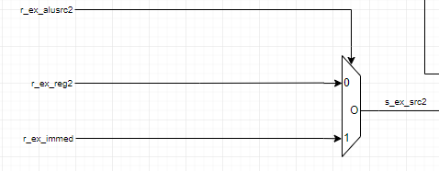
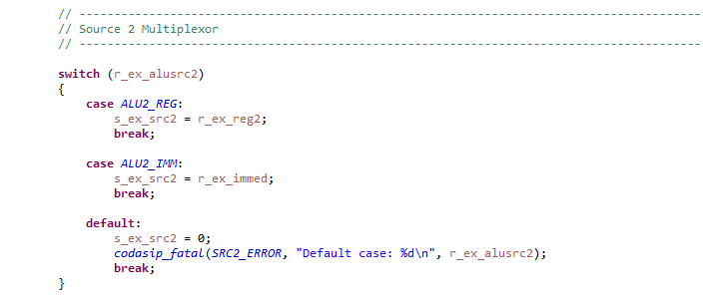
Codasip – Multiplexor Example
Schematic of a mux
Codal version 1 – switch statement on the Control signal
Has a CASE for each enum
Default prints an error which helps in debug

Slide 10
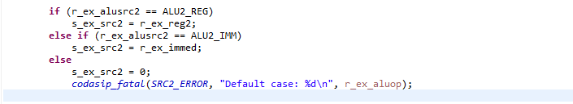

Codasip – Multiplexor Example 2
Alternate mux implementations
if/else instead of switch
If/else for a 1-bit Control signal
?/: statement for a 1-bit Control signal
The last two are much harder to understand and not recommended

Slide 11
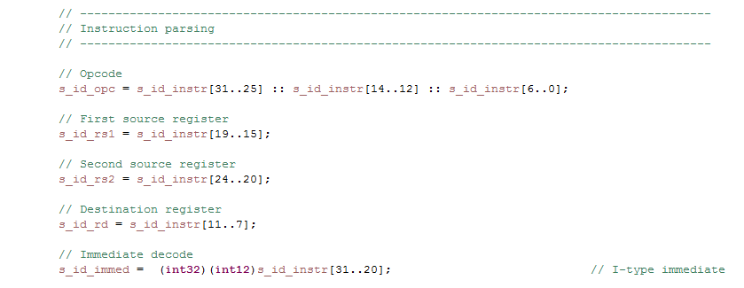
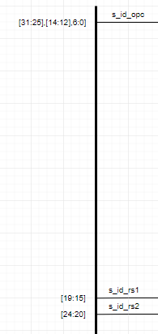
Class Project – Phase 5
Bit Field Syntax
Double periods indicate a bit range (NOT “:”)
A 1-bit range must include 2 values (e.g. [7..7])
Double colons indicate concatenation
int12 creates a signed 12-bit value
int32 sign extends the value to 32 bits
This defines the signals which are broken out of the s_id_instr bus on the ID Stage schematic

Slide 12
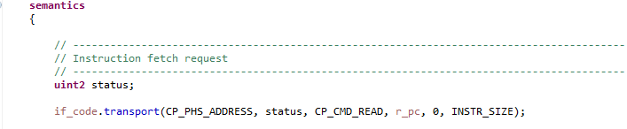
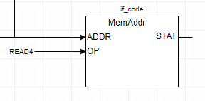
Class Project – Phase 5
Accessing the Instruction Memory (IF Stage)
Address part function
Defines the address phase (IF Stage schematic)
Defines the operation (always read for IM)
Defines the word address
Defines the byte offset
Defines the access length (4 bytes here)

Slide 13
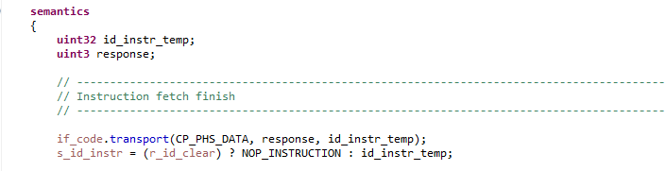
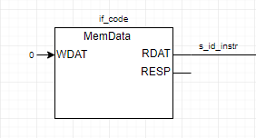
Class Project – Phase 5
Accessing the Instruction Memory (ID Stage)
Data part function
Defines the data phase (ID Stage schematic)
Read output
Handles the -1st instruction
Force it to be a NOP
r_id_clear initialized to 1, then set to 0

Slide 14
More realistic Branch Prediction Methods
Static branch prediction
Based on typical branch behavior
Example: assume loop and if-statement branches
Predict backward branches taken (assume bottom of a loop)
Predict forward branches not taken (assume IF statement)
Dynamic branch prediction
Hardware measures actual branch behavior
e.g., record recent history of each branch
Assume future behavior will continue the trend
When wrong, stall while re-fetching, and update history

Slide 15
How Will We Implement Branch Prediction?
For simplicity, we will implement static prediction but always assume the branch is not taken
What is the penalty for this?
Every branch which is taken, even in a loop, will result in three instructions being FLUSHED

Slide 16
Pipeline Summary
Pipelining improves performance by increasing instruction throughput
Executes multiple instructions in parallel
Each instruction has the same latency
The instruction latency could be greater than a single-cycle CPU implementation if the stages are non-balanced
Subject to hazards
Structure, data, control
Instruction set design affects complexity of pipeline implementation

